Slide 1
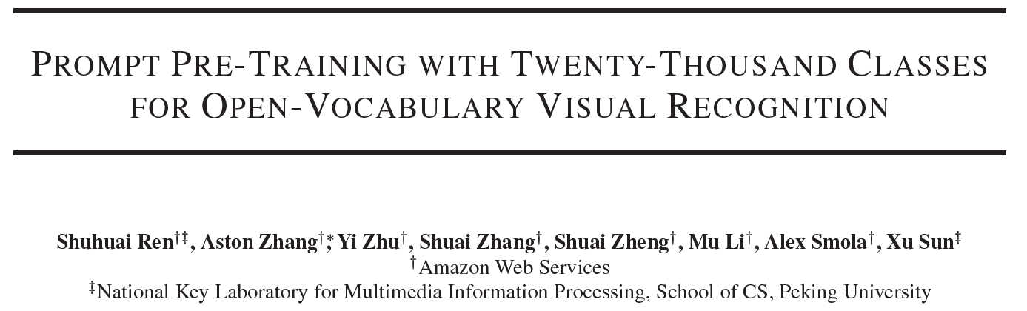
Not Published Yet
Mingle Xu
2023 June 7

Slide 2
Content
What is open-vocabulary recognition?
What is prompt engineering?
Why should we use prompt engineering?
What are the challenges to using prompt engineering?

Slide 3
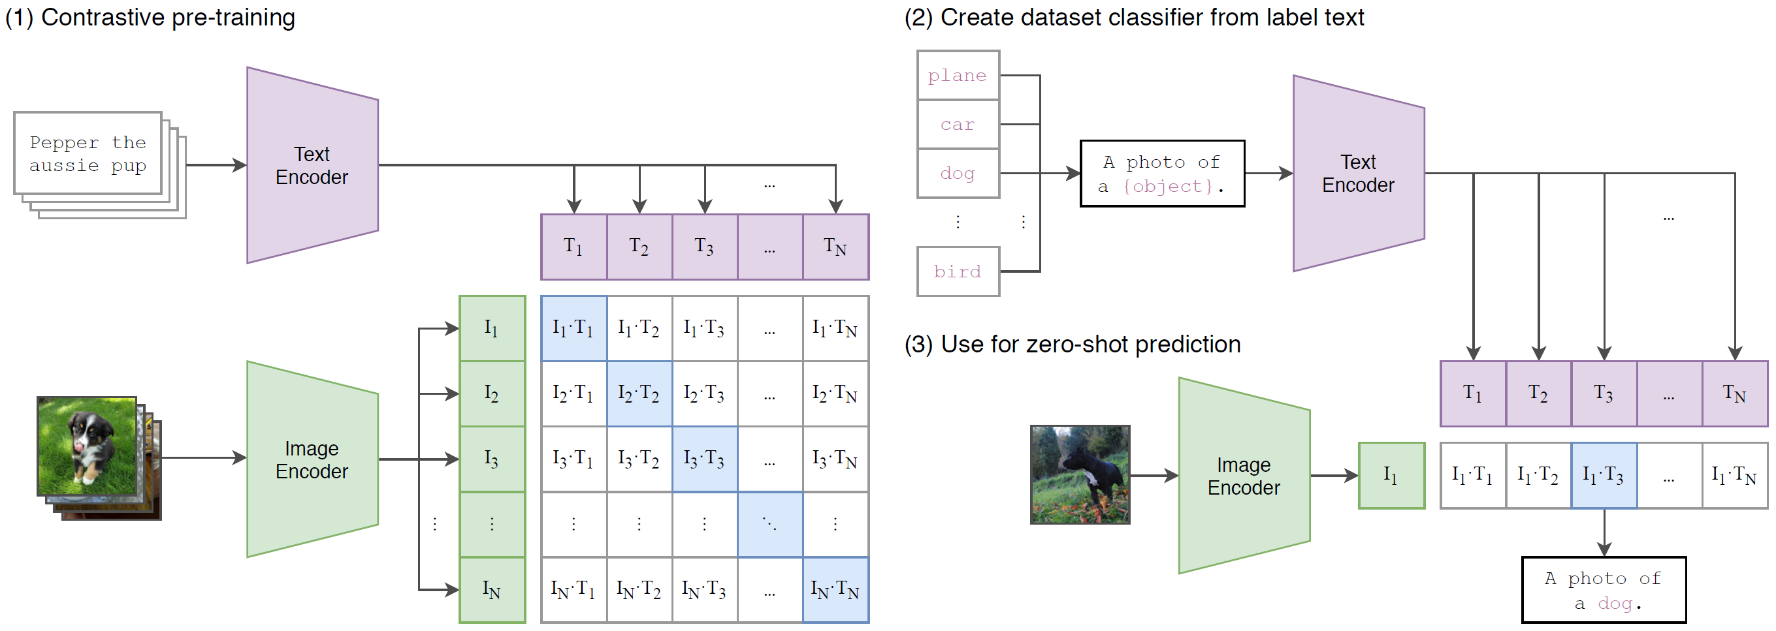
Background: language-guided visual recognition (CLIP)
Advantage: better representation learning.
Paradigm: formulate image classification as an image-text matching problem.
Radford, Alec, et al. "Learning transferable visual models from natural language supervision." ICLR, 2021.
Radford, Alec, et al. "Learning transferable visual models from natural language supervision." ICLR, 2021.

Slide 4
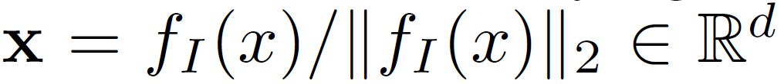
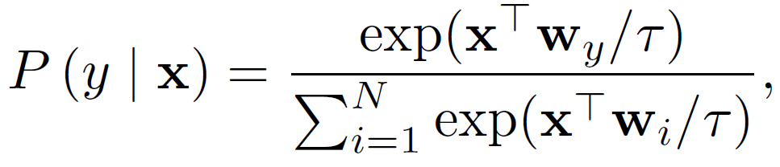
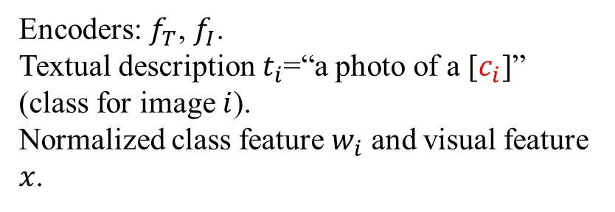
Background: language-guided visual recognition (CLIP)
Advantage: open-vocabulary inference, or zero-shot recognition.
Relation and difference: open set recognition, open world.
Encoders: $f_{T}$, $f_{I}$.
Textual description $t_{i}$=“a photo of a [$c_{i}$]” (class for image $i$).
Normalized class feature $w_{i}$ and visual feature $x$.
Radford, Alec, et al. "Learning transferable visual models from natural language supervision." ICLR, 2021.

Slide 5
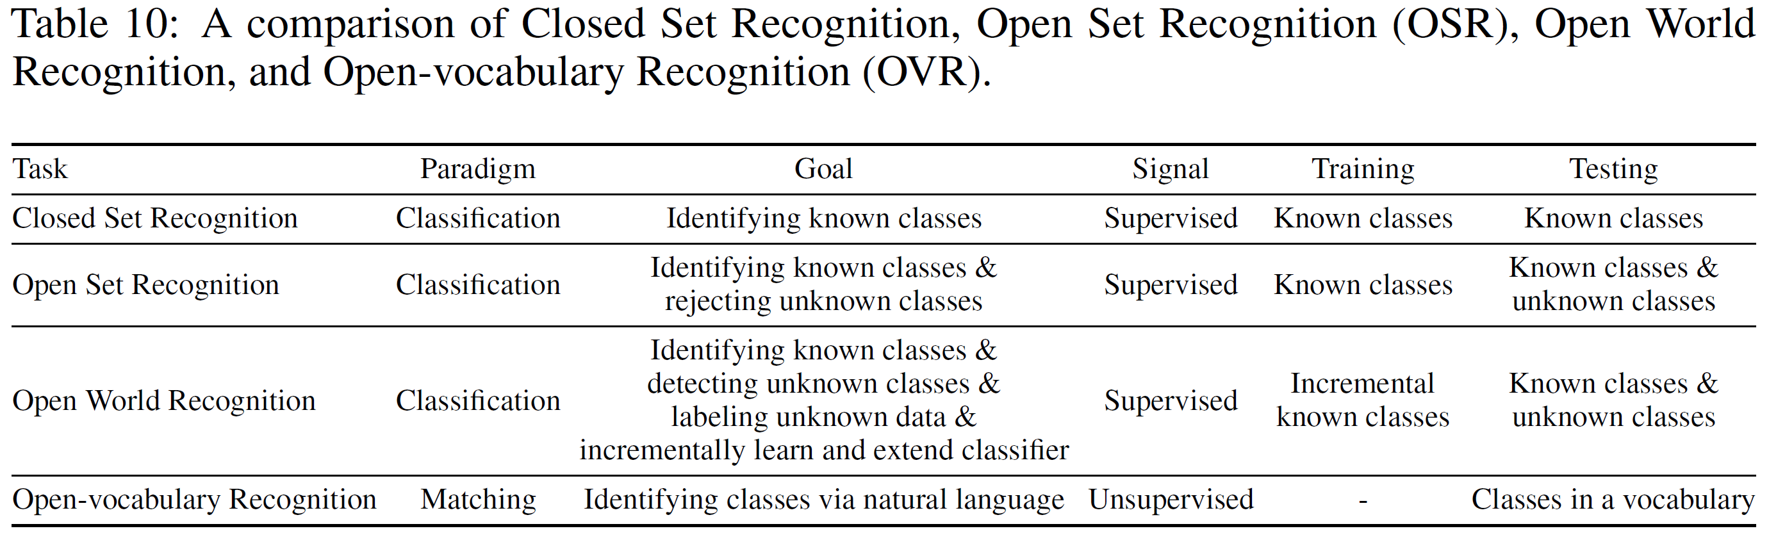
Comparison of different tasks
Do not need training in the target dataset.
Finetuning is another way and may be better.
Ren, Shuhuai, et al. "Delving into the Openness of CLIP." (2023).

Slide 6
Content
What is open-vocabulary recognition?
What is prompt engineering?
Why should we use prompt engineering?
What are the challenges to using prompt engineering?

Slide 7
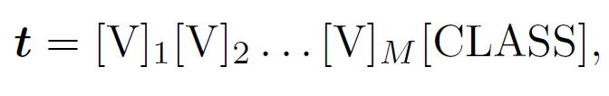
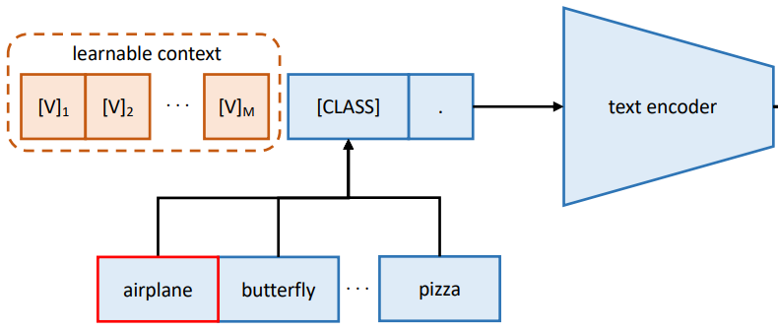
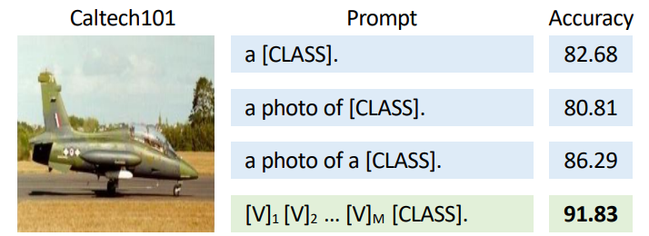
Background: prompt
Key issue: distribution shift. Word and sentence.
Observation: diverse performance with prompts.
From hard to soft prompt: learning the prompt.
Text encoder.
Unified text prompt.
Class-specific text prompt, better for fine-grained task.
Zhou, Kaiyang, et al. "Learning to prompt for vision-language models." IJCV 2022.

Slide 8
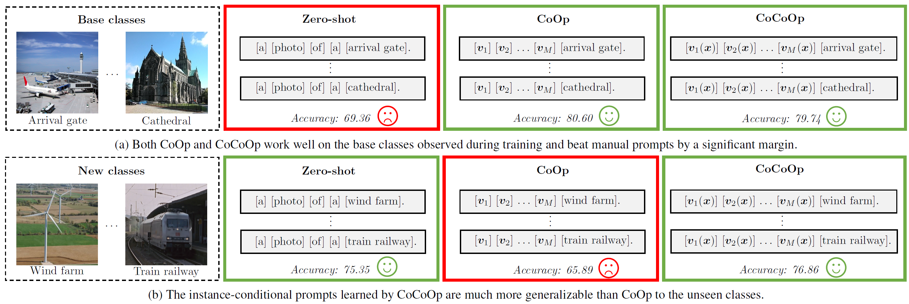
Background: prompt
Distribution shift between the fine-tuning and test datasets.
Zhou, Kaiyang, et al. "Conditional prompt learning for vision-language models. CVPR 2022.

Slide 9
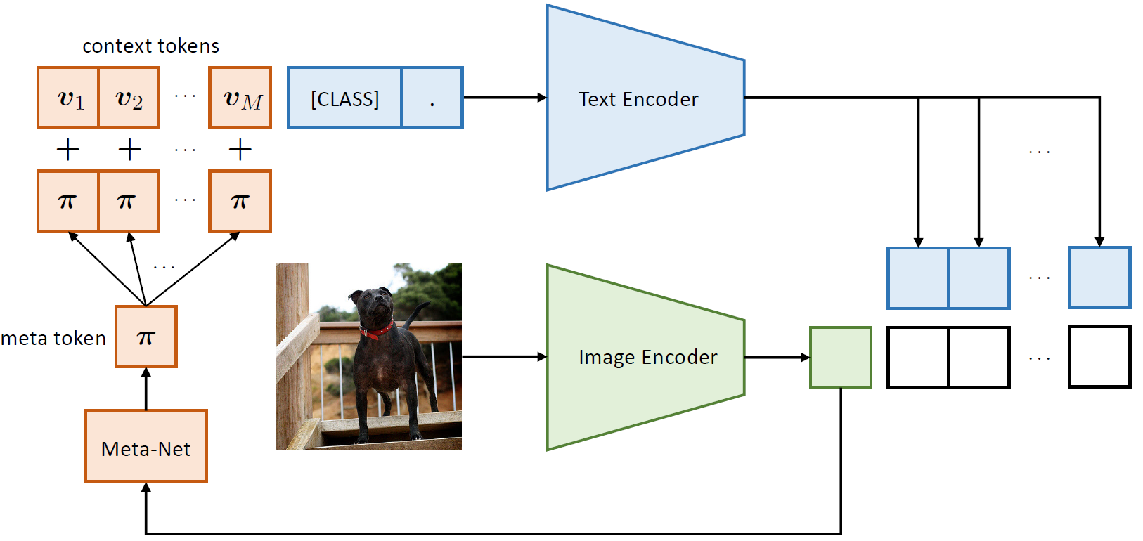
Background: prompt
Conditional prompt learning.
Zhou, Kaiyang, et al. "Conditional prompt learning for vision-language models. CVPR 2022.

Slide 10
Zhou, Kaiyang, et al. "Conditional prompt learning for vision-language models. CVPR 2022.

Slide 11
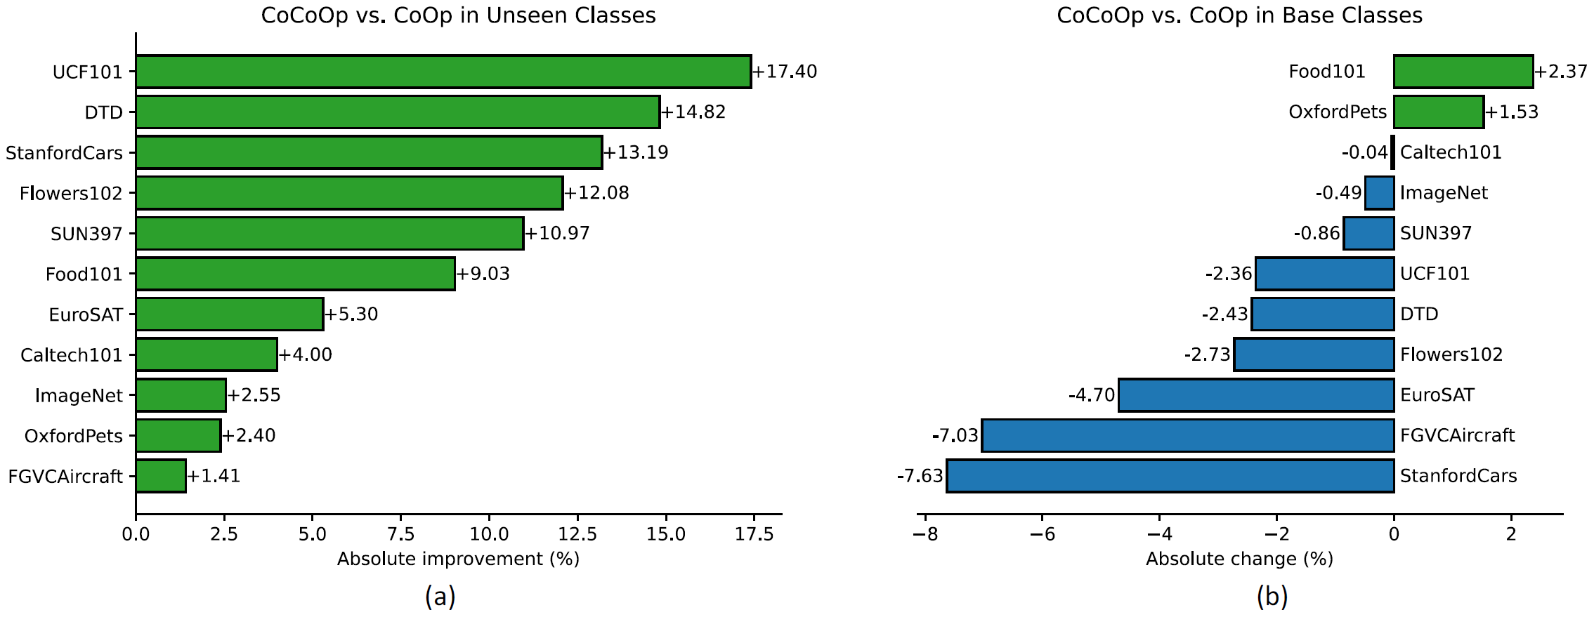
Zhou, Kaiyang, et al. "Conditional prompt learning for vision-language models. CVPR 2022.

Slide 12
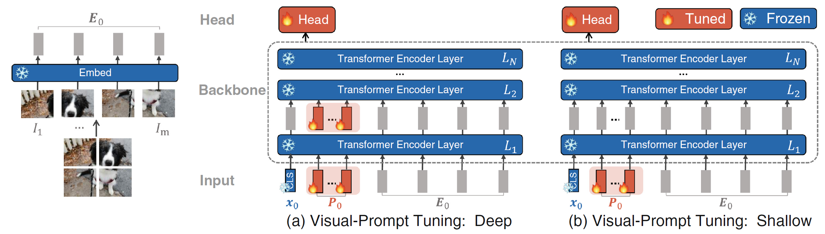
Background: prompt
When we are only interested in the image encoder, the text prompt is not useful.
Taking the image encoder as representation learning and fine-tune it for downstream tasks.
Learning the prompt for image encoder.
Jia, Menglin, et al. "Visual prompt tuning." ECCV 2022

Slide 13
A short summary
CLIP: open vocabulary with potential performance.
Hard prompt is kind of prompt engineering.
Learning prompt:
Better performance.
Parameter efficient learning.
Suffer from distribution shift between fine-tuning and test datasets.

Slide 14
Appetizers before the main paper sharing
Interesting properties of Open-Vocabulary of CLIP

Slide 15
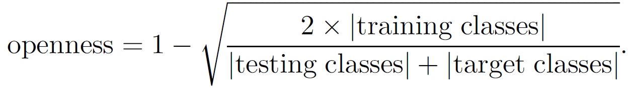
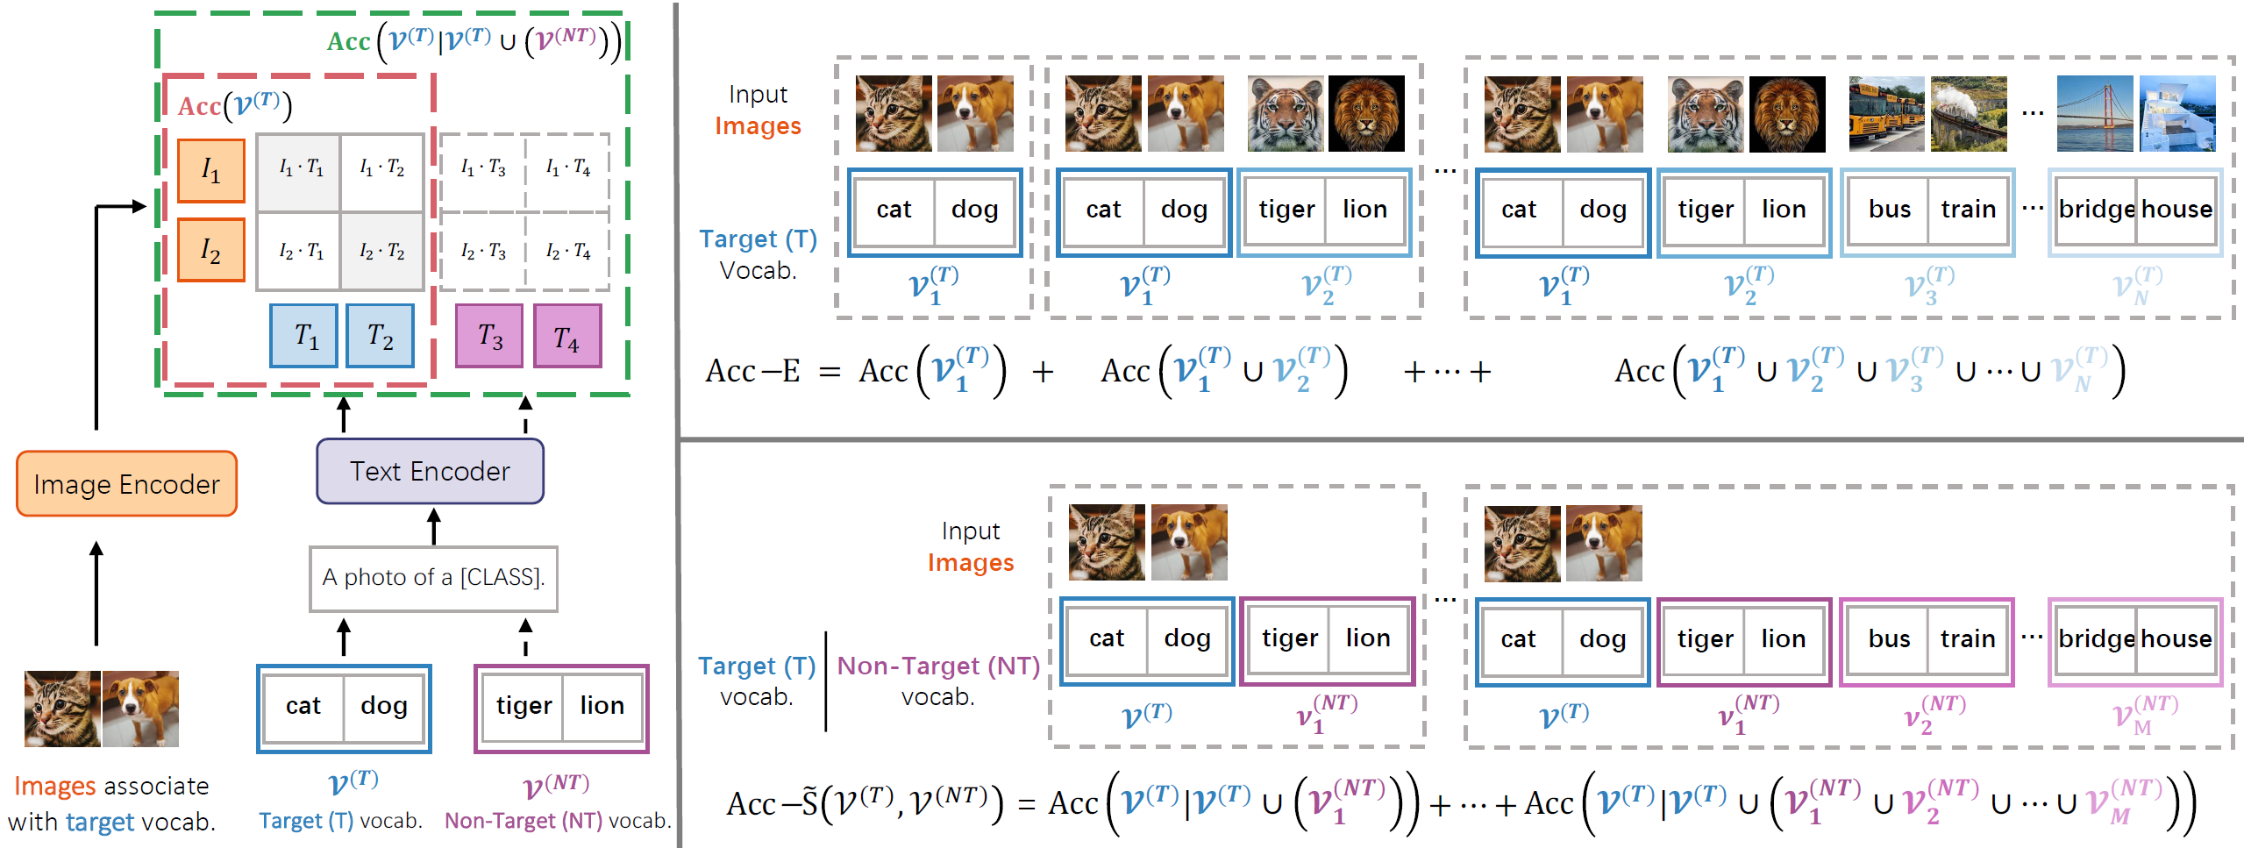
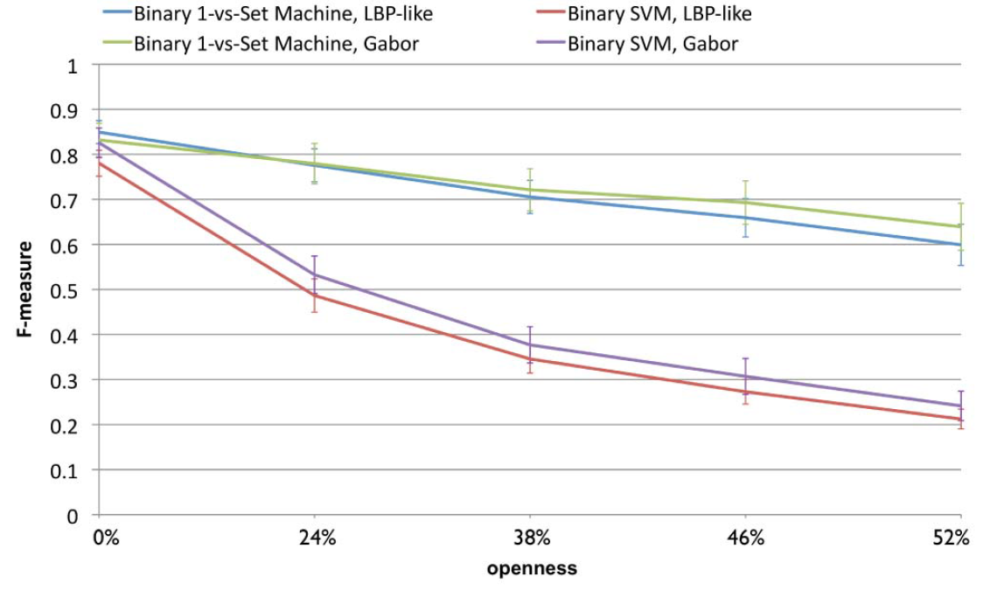
More interesting properties of Open-Vocabulary of CLIP
Recall openness.
Key question: when the number of classes and/or images are increasing, are there any open-vocabulary accuracy changes?
Original and conditional accuracy.
"Toward open set recognition.“ PAMI 2013.
Ren, Shuhuai, et al. "Delving into the Openness of CLIP." (2023).

Slide 16
More interesting properties of Open-Vocabulary of CLIP
Extensibility: more classes with corresponding images
Stability: only new classes.
Ren, Shuhuai, et al. "Delving into the Openness of CLIP." (2023).

Slide 17
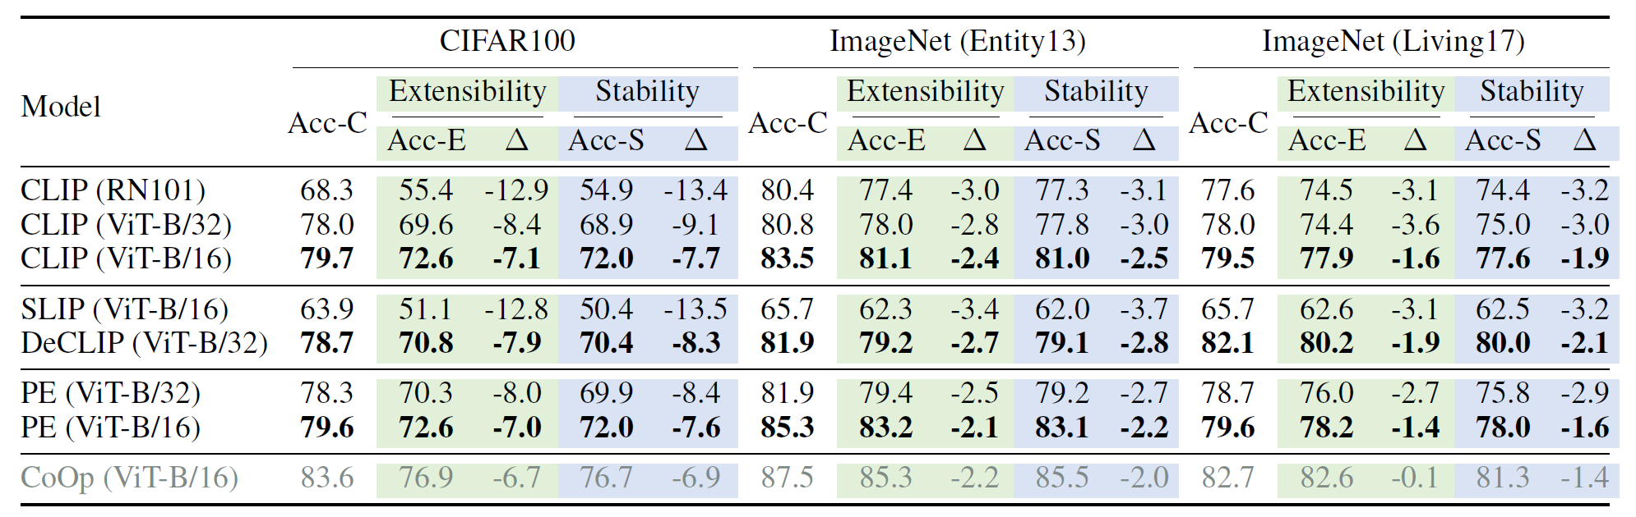
Ren, Shuhuai, et al. "Delving into the Openness of CLIP." (2023).

Slide 18
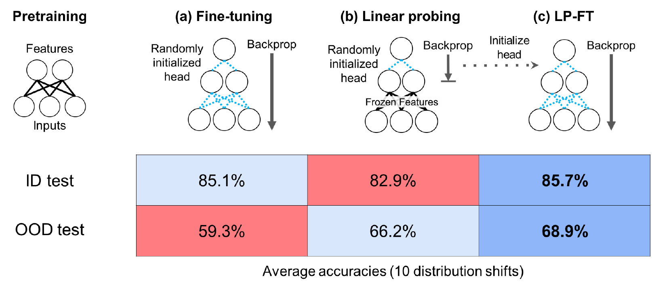
Distribution shift issue in the era of foundation and big models.
CLIP as a pre-trained model.
Kumar, Ananya, et al. "Fine-Tuning can Distort Pretrained Features and Underperform Out-of-Distribution." ICLR. 2022.

Slide 19
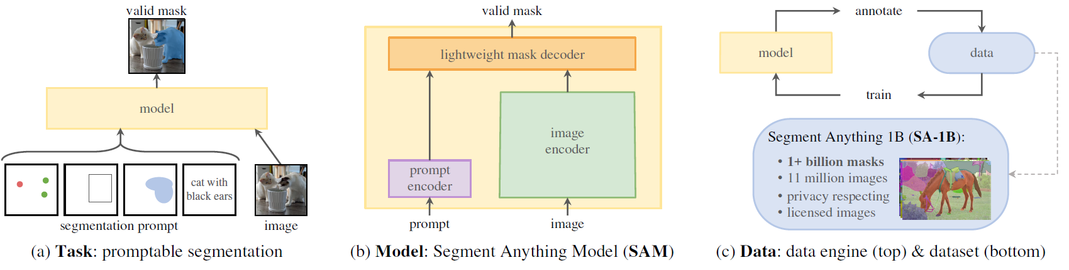
Distribution shift issue in the era of foundation and big models.
Segment Anything model (SAM).
Original training dataset:
Kirillov, Alexander, et al. "Segment anything." arXiv preprint arXiv:2304.02643 (2023).

Slide 20
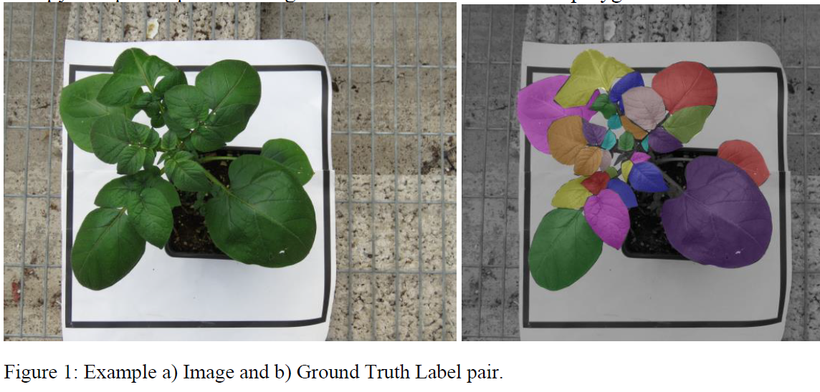
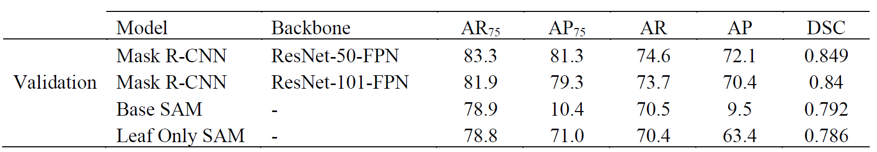
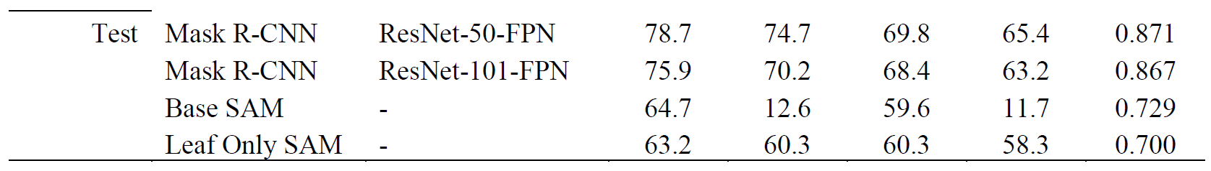
Distribution shift issue in the era of foundation and big models.
SAM in potato leaf segmentation without finetuning.
Compared to finetuned Mask R-CNN
Williams, et.al. "Leaf Only SAM: A Segment Anything Pipeline for Zero-Shot Automated Leaf Segmentation." arXiv (2023).

Slide 21
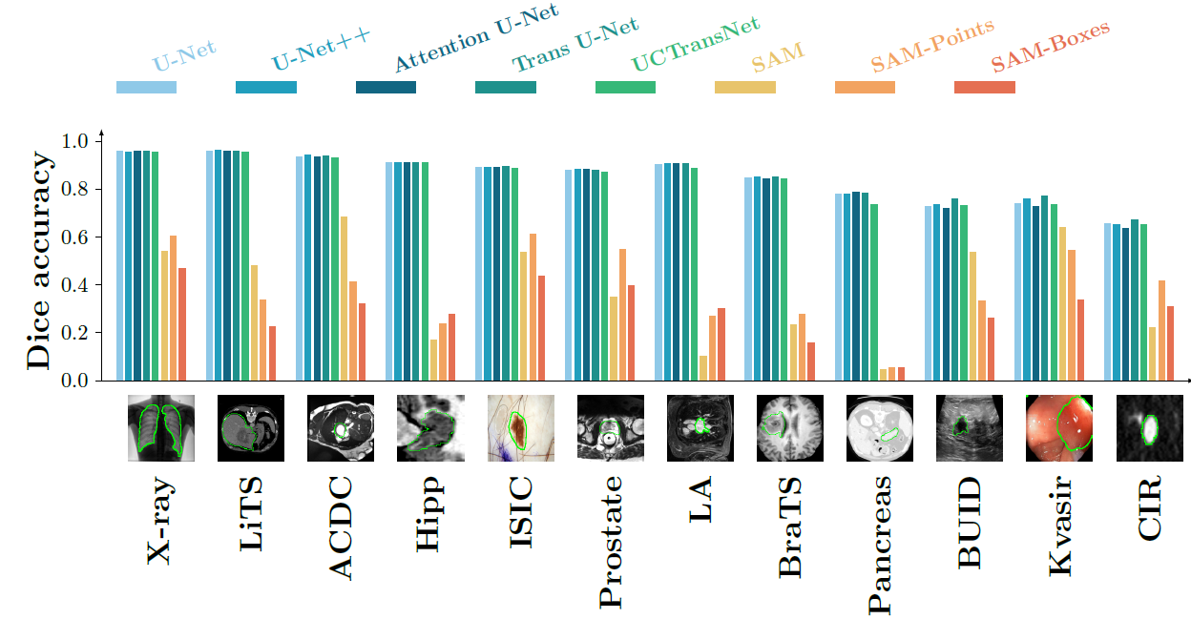
Distribution shift issue in the era of foundation and big models.
SAM in medical image segmentation without finetuning.
He, Sheng, et al. "Accuracy of segment-anything model (sam) in medical image segmentation tasks." arXiv (2023).

Slide 22
Observation: leaf segmentation is better than medical image segmentation.
Why?
Maybe the distribution shift is smaller in leaf segmentation.
Currently, I do not fully know the CLIP and SAM datasets.

Slide 23
Main course today
Main issue: distribution shift in current studies, few classes.
→ universal soft prompt on large-scale datasets with massive visual categories.
Learning prompt on the ImageNet-21k dataset.
Brute?

Slide 24
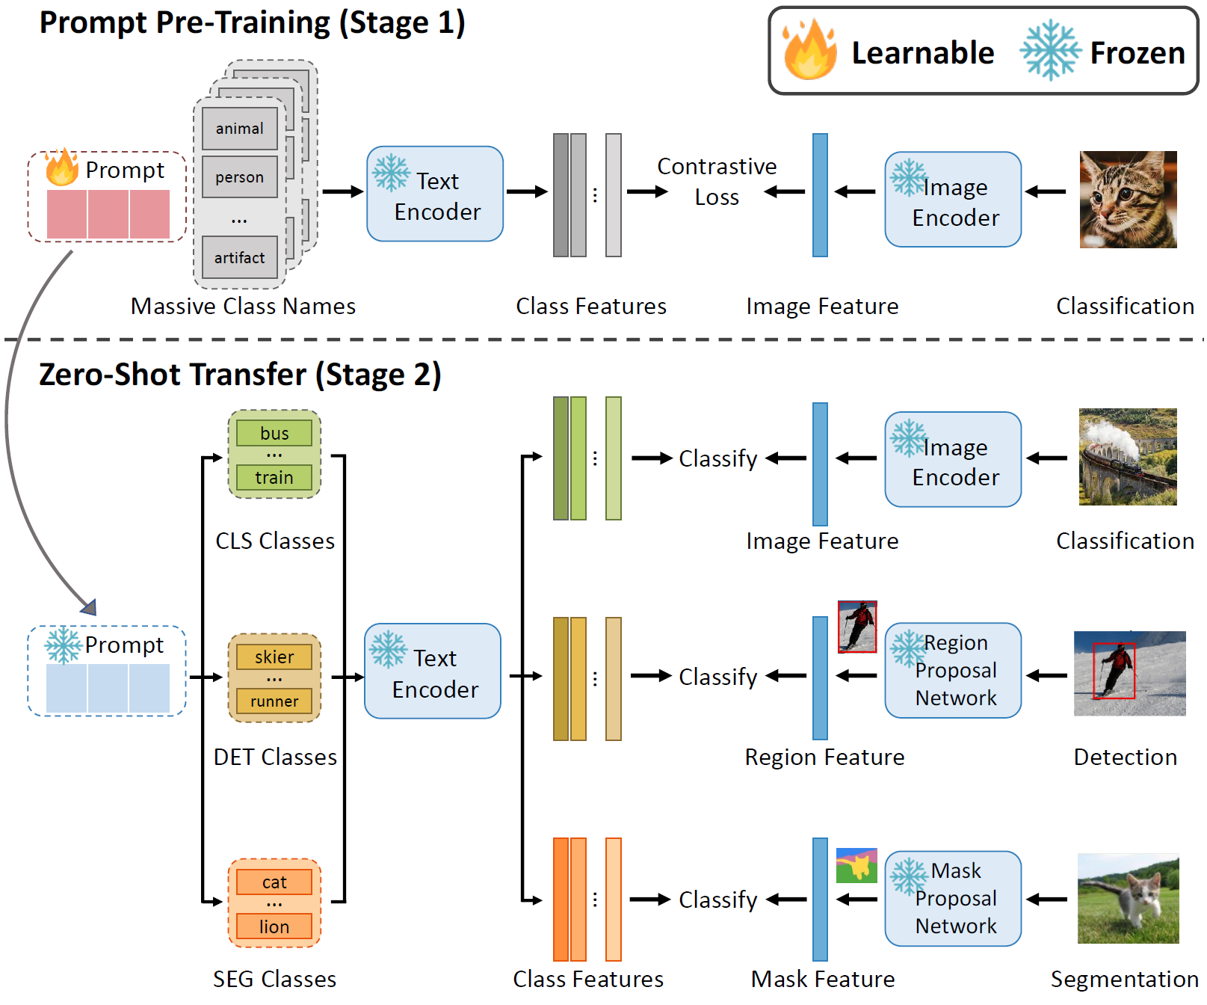
Memory problem with class-specific learnable prompt: 21k*15MB > 300GB

Slide 25
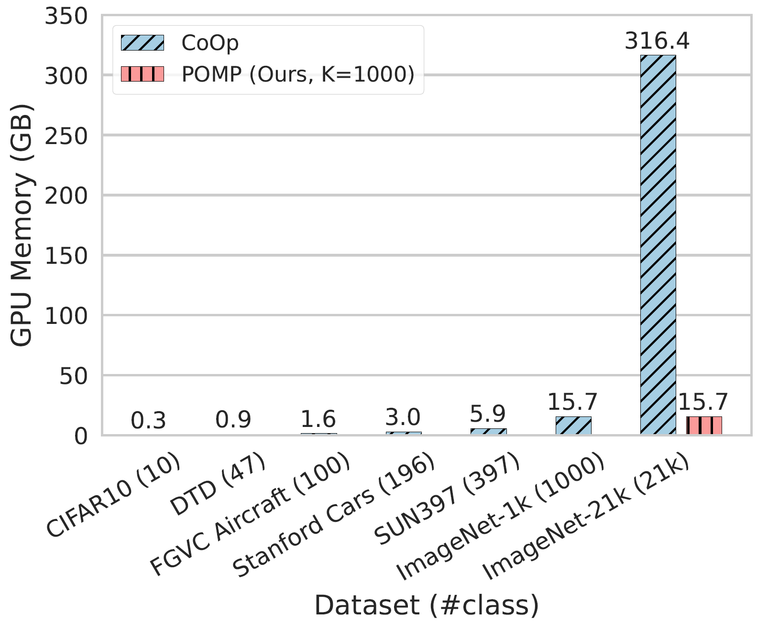
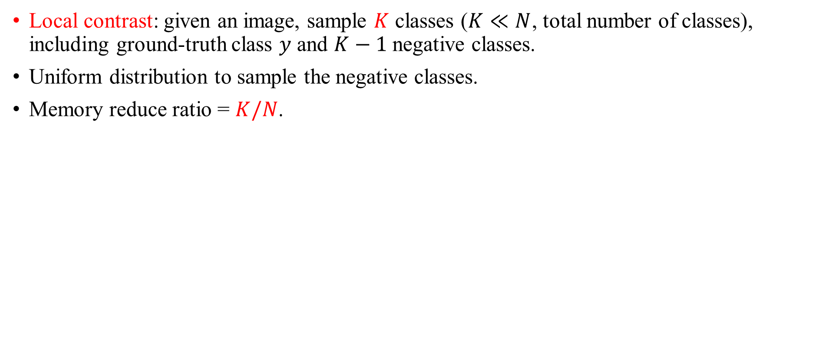
Local contrast
Local contrast: given an image, sample $K$ classes ($K≪N$, total number of classes), including ground-truth class $y$ and $K−1$ negative classes.
Uniform distribution to sample the negative classes.
Memory reduce ratio = $K/N$.

Slide 26
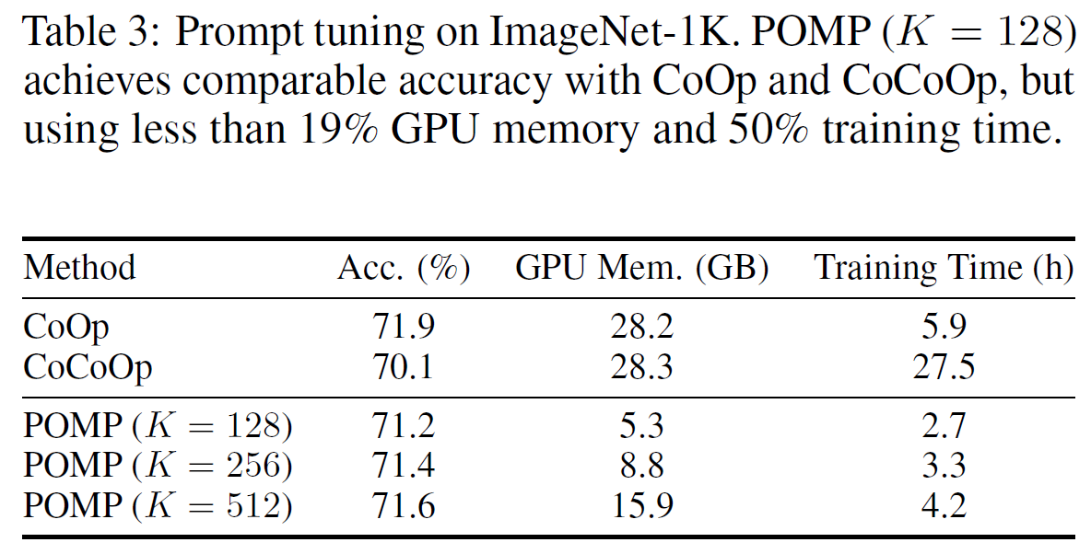
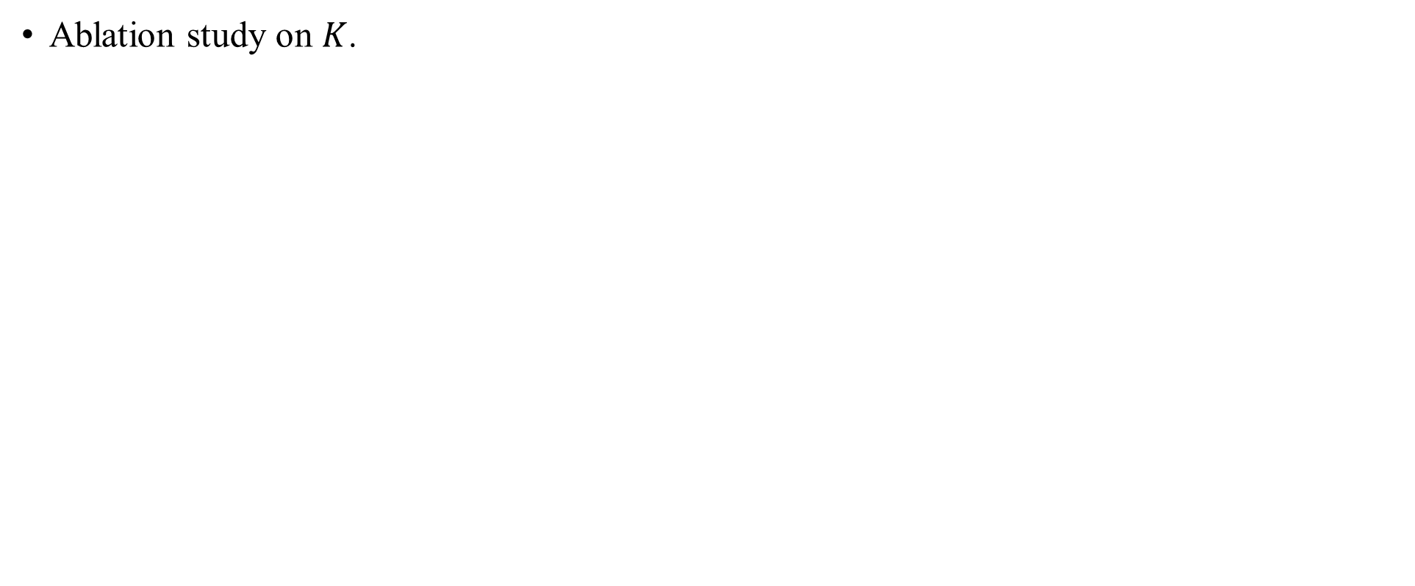
Ablation study on $K$.

Slide 27
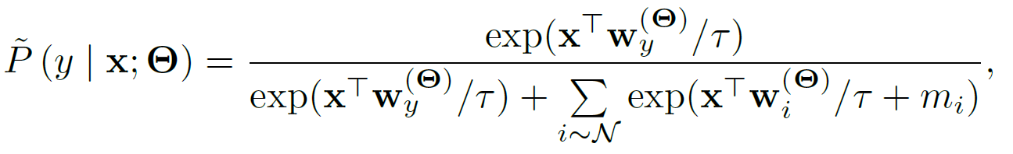
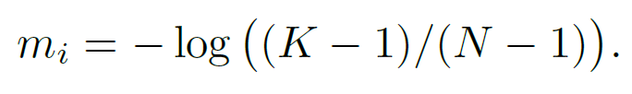
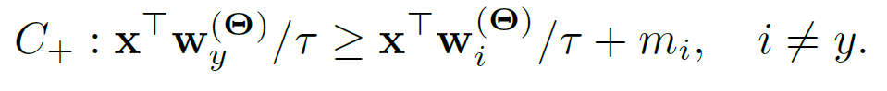
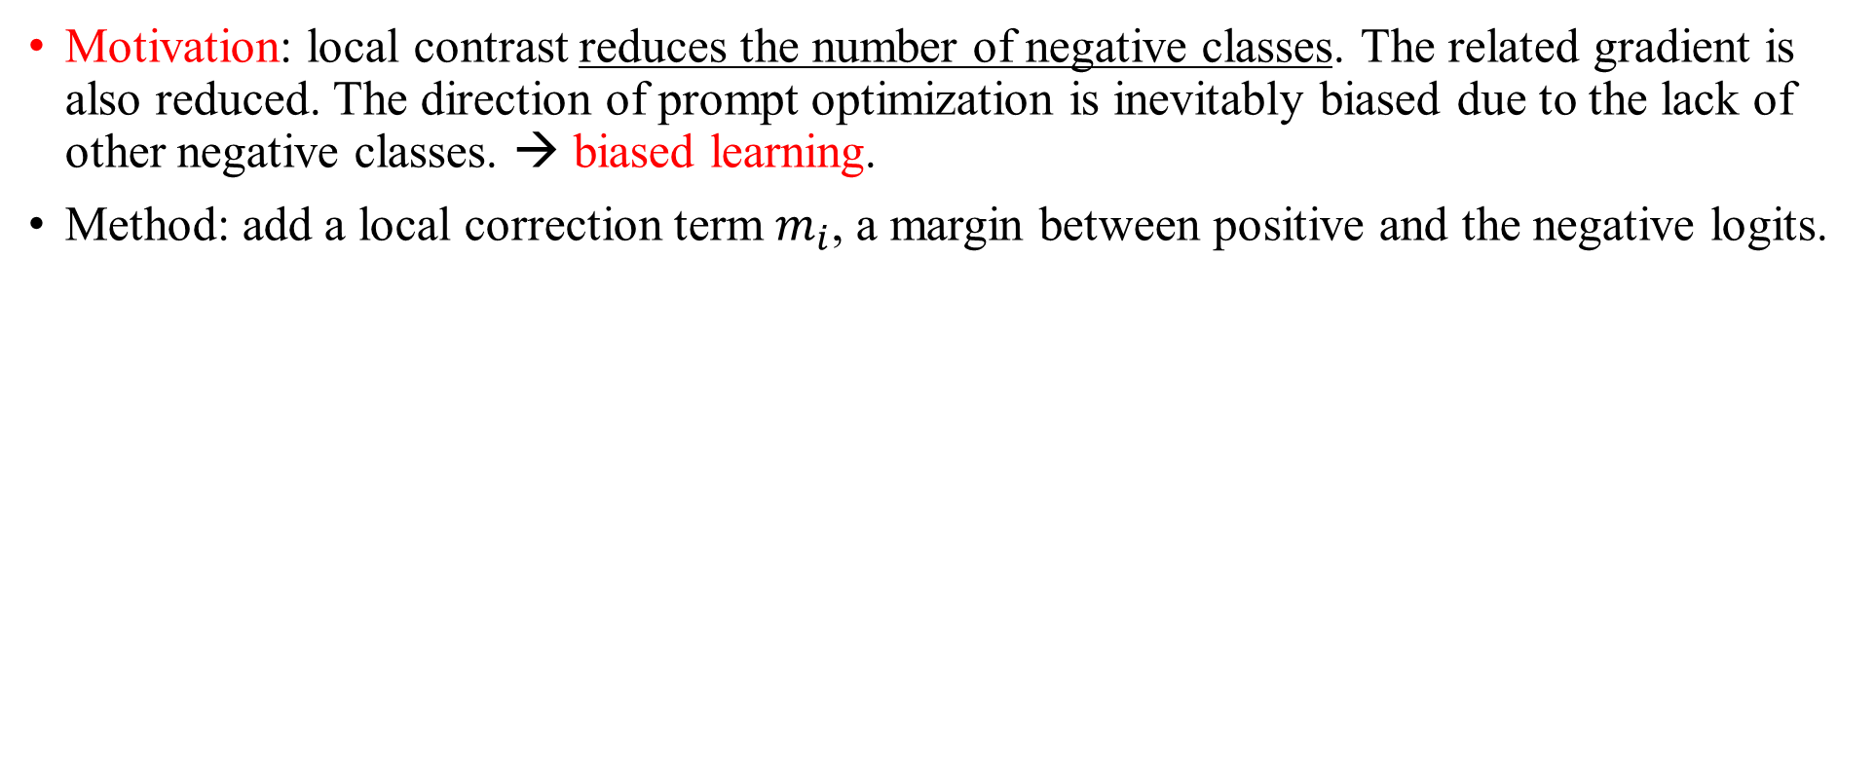
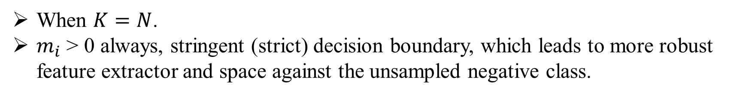
Local correction
Motivation: local contrast reduces the number of negative classes. The related gradient is also reduced. The direction of prompt optimization is inevitably biased due to the lack of other negative classes. → biased learning.
Method: add a local correction term $m_{i}$, a margin between positive and the negative logits.
When $K=N$.
$m_{i}$ > 0 always, stringent (strict) decision boundary, which leads to more robust feature extractor and space against the unsampled negative class.

Slide 28
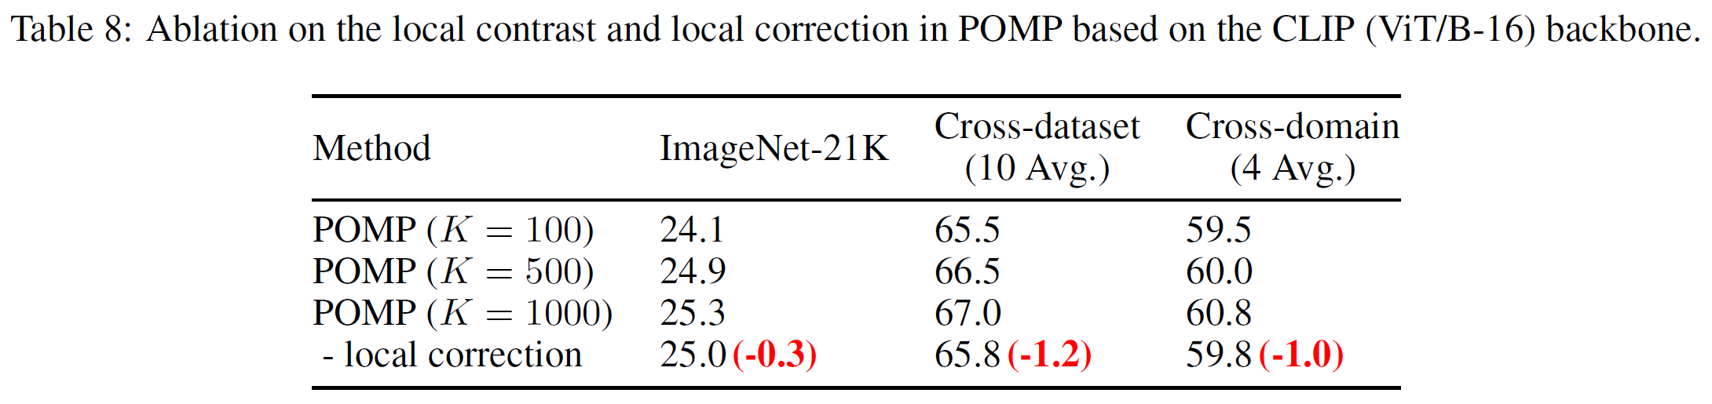
Ablation study on the two modules

Slide 29
Method: for downstream tasks
Pretrain proposal networks.

Slide 30
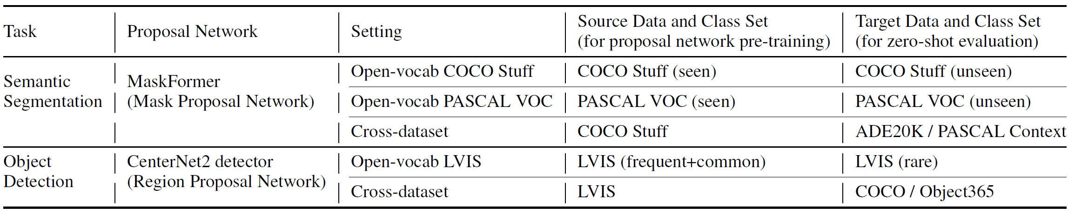
Experimental settings
Proposal networks: pretrain in source dataset and test in target dataset.
Protocol:
Open-vocabulary: one dataset → source and target.
Cross-dataset: one → source and another one →target.

Slide 31
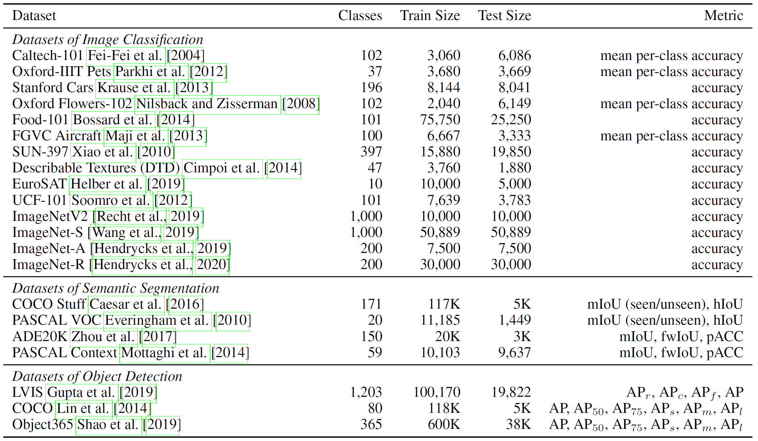
Experimental settings

Slide 32
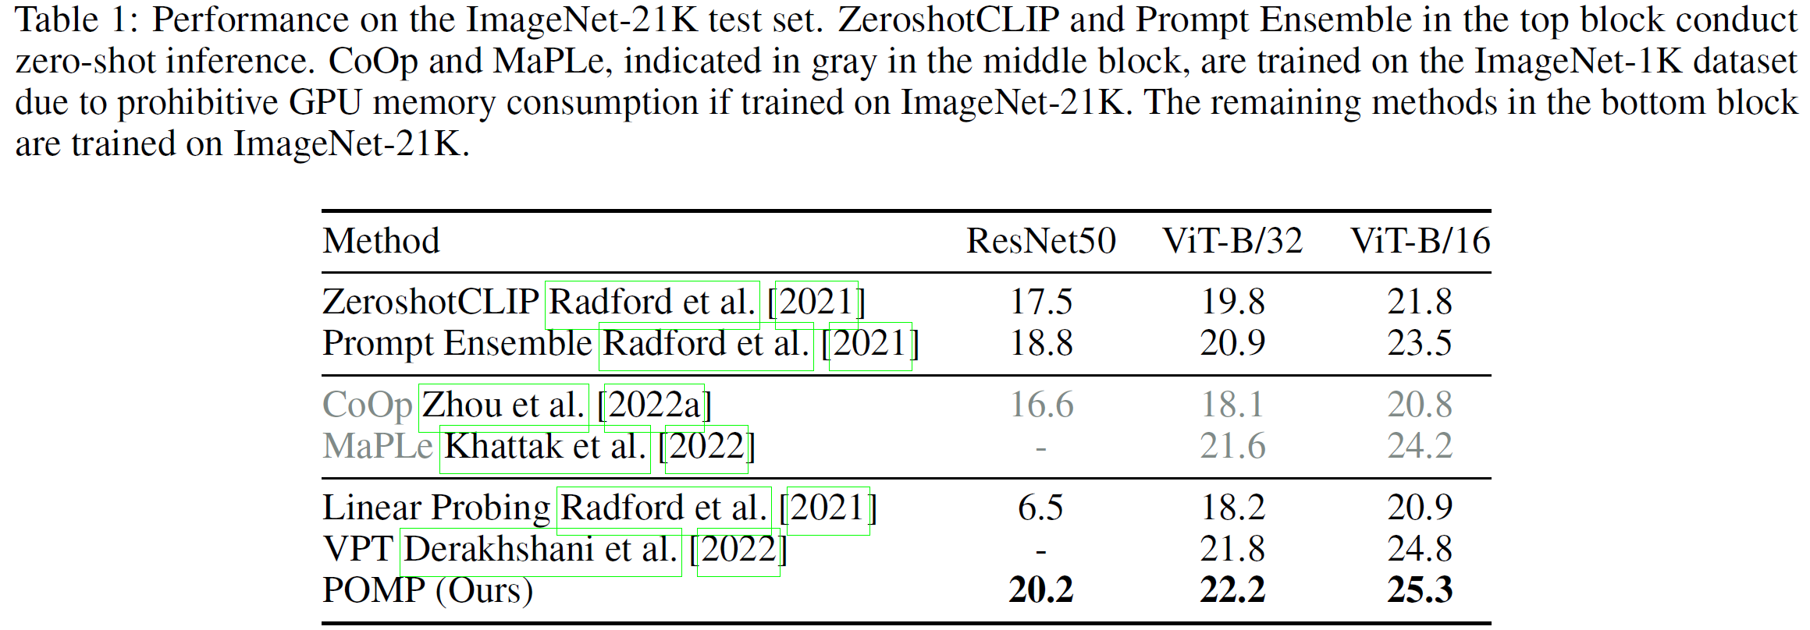
Experiments: image classification

Slide 33
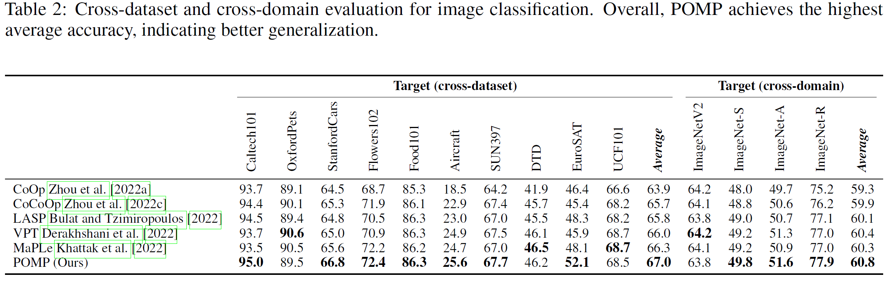
Experiments: image classification

Slide 34
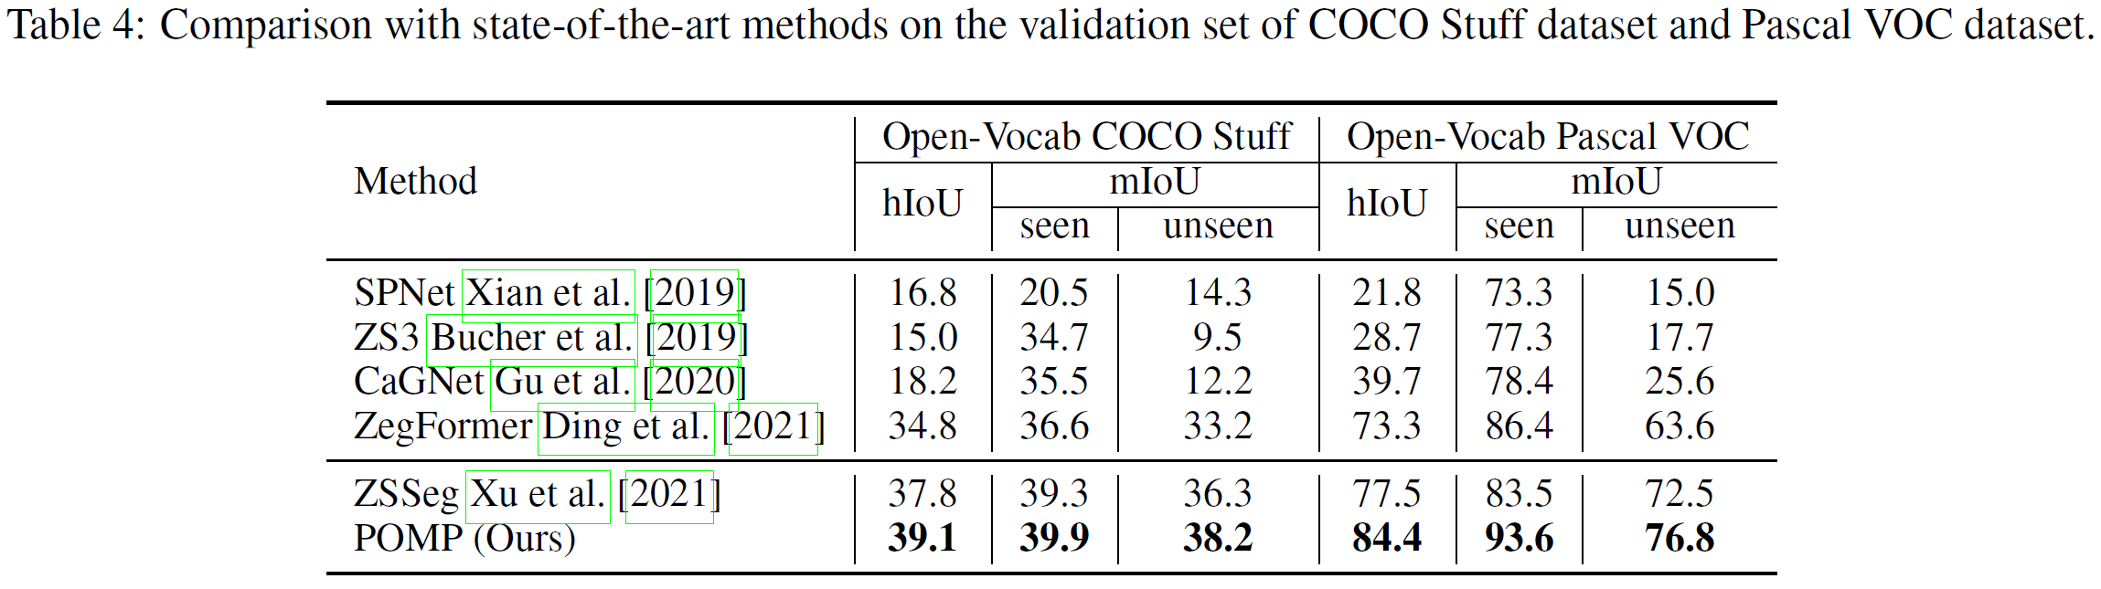
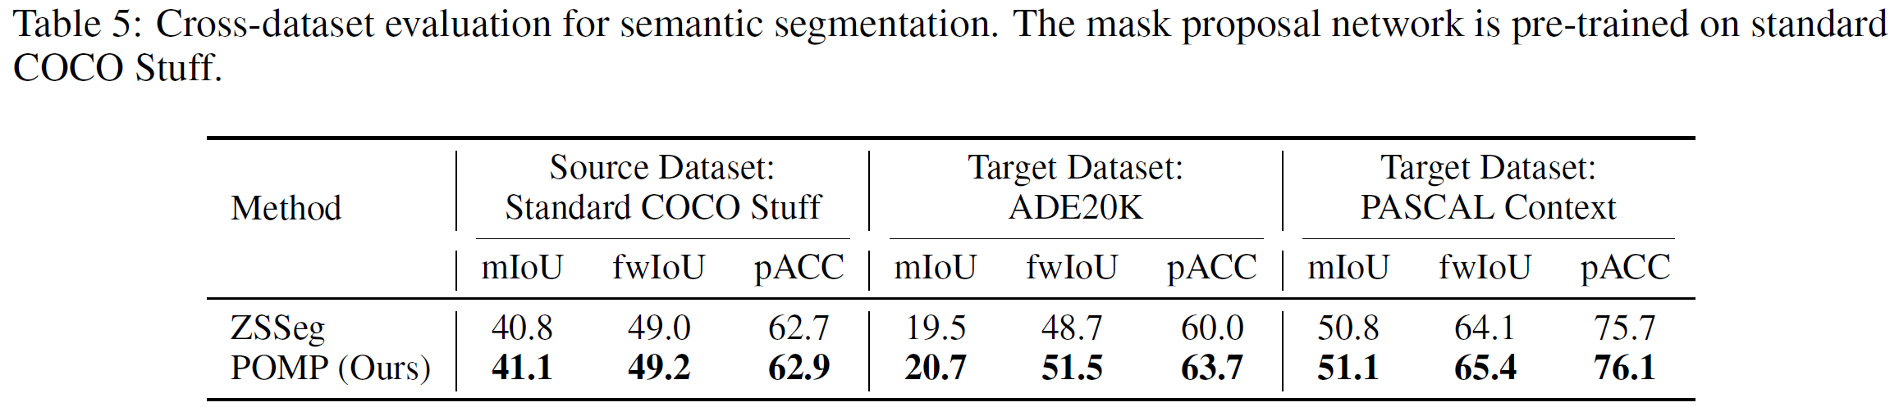
Experimental results: Open-Vocabulary Semantic Segmentation

Slide 35
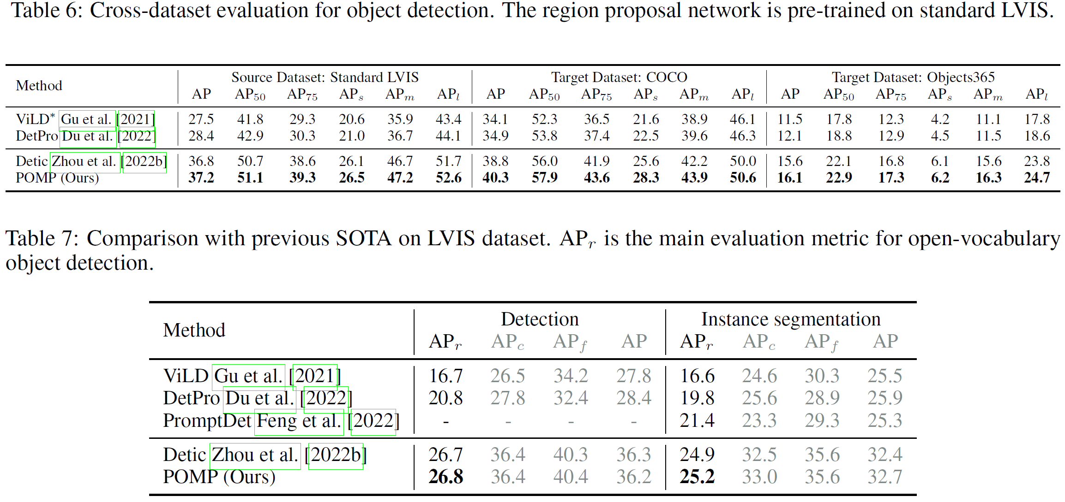
Experimental results: Open-Vocabulary Object Detection

Slide 36
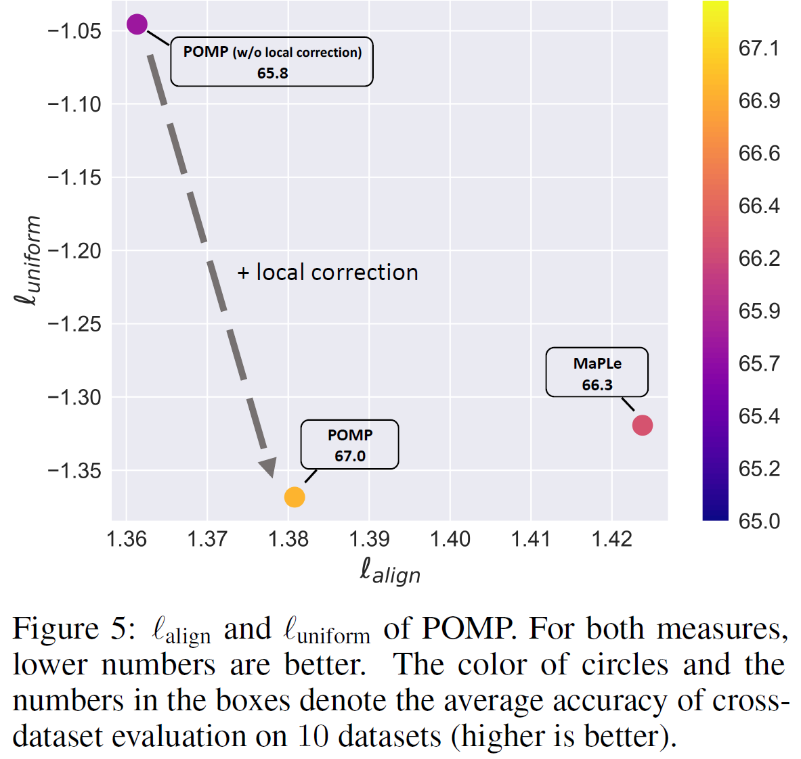
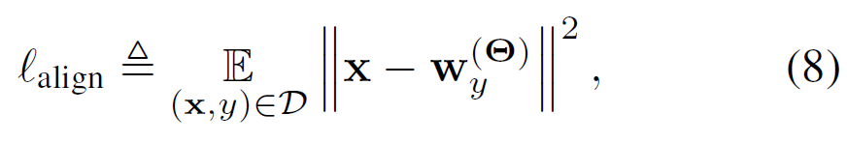
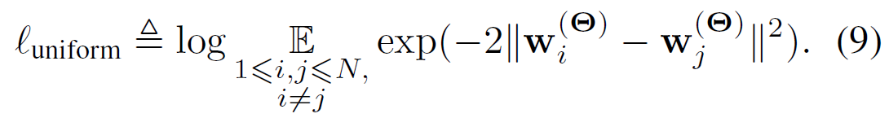
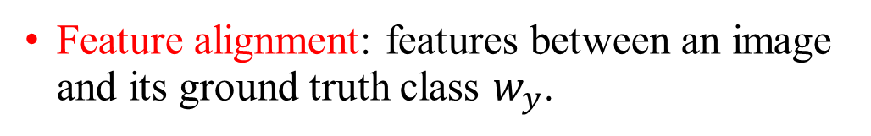
Experimental results: feature space probing
Feature alignment: features between an image and its ground truth class $w_{y}$.
Uniformity distribution: how well the class features are uniformly distributed.
POMP: reduces uniformity a lot cost at a slight increase in alignment. → improving the generalization and robustness of the model.

Slide 37
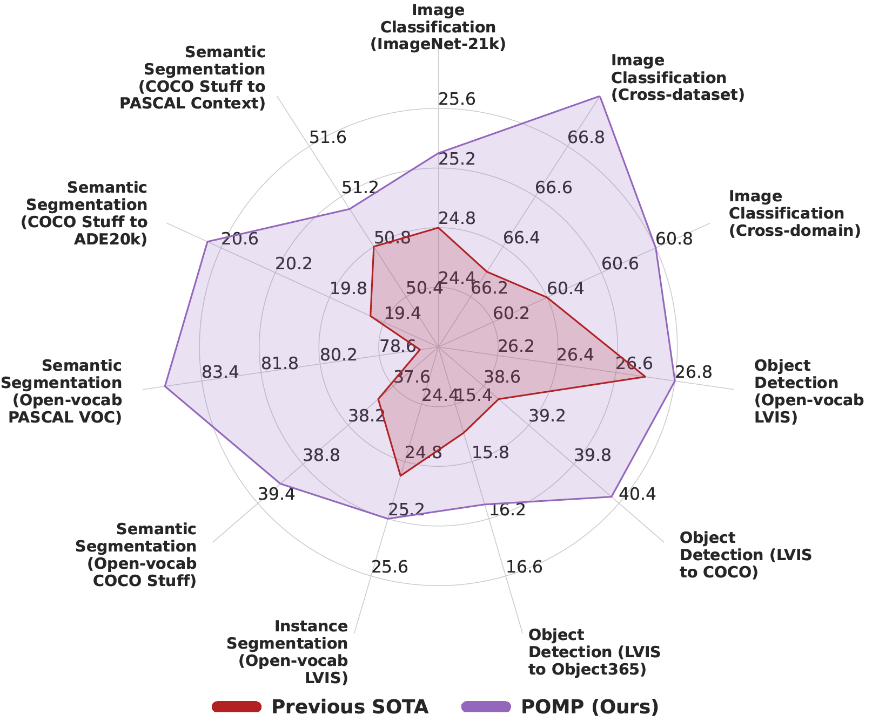
Conclusion and personal understandings
Open-vocabular
To reduce the impact of the distribution shift:
21k classes pretraining
Parameter-efficient method: local contrast and local correction.
Is ImageNet-21k enough? What’s the future?
In the era of foundation models and big models
Parameter-efficient should be highlighted.
Distribution shift still exists and should be noticed.
Segment anything → medical images
CLIP for plant disease
Hints for OSR and Open World: better feature learning.

